Slide 1

CHAPTER 4
ELEMENTARY NUMBER THEORY AND METHODS OF PROOF
Copyright © Cengage Learning. All rights reserved.

Slide 2

4.4
Direct Proof and Counterexample Ⅳ: Divisibility
Copyright © Cengage Learning. All rights reserved.

Slide 3

Direct Proof and Counterexample Ⅳ: Divisibility
When you were first introduced to the concept of division in elementary school, you were probably taught that 12 divided by 3 is 4 because if you separate 12 objects into groups of 3, you get 4 groups with nothing left over.
You may also have been taught to describe this fact by saying that “12 is evenly divisible by 3” or “3 divides 12 evenly.”

Slide 4
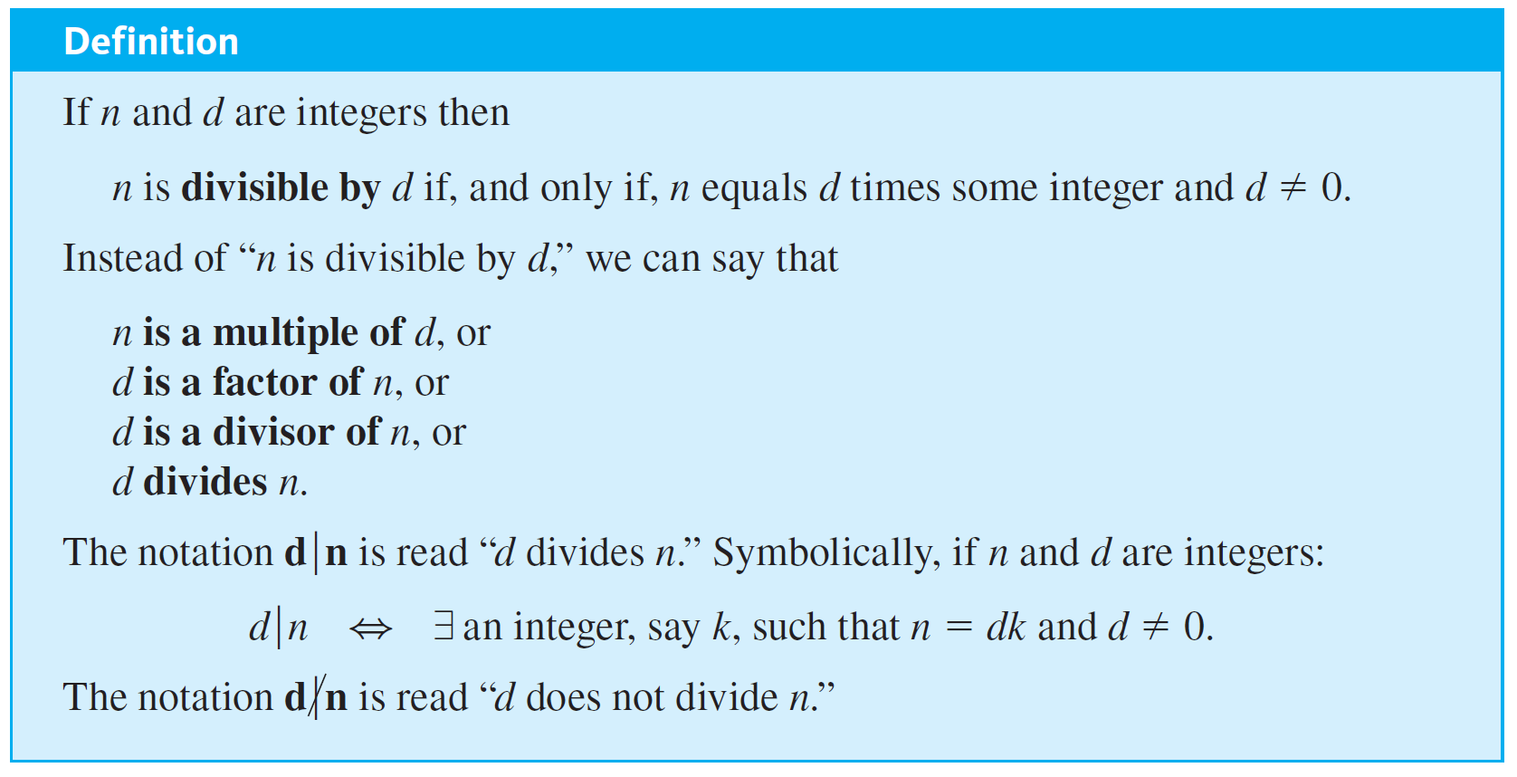
Direct Proof and Counterexample Ⅳ: Divisibility
The notion of divisibility is the central concept of one of the most beautiful subjects in advanced mathematics: number theory, the study of properties of integers.

Slide 5

Example 4.4.1 – Divisibility
a. Is 21 divisible by 3?
b. Does 5 divide 40?
c. Does
d. Is 32 a multiple of −16?
e. Is 6 a factor of 54?
f. Is 7 a factor of −7?

Slide 6
Example 4.4.1 – Solution
a. Yes, 21 = 3 · 7.
b. Yes, 40 = 5 · 8.
c. Yes, 42 = 7 · 6.
d. Yes, 32 = (−16) · (−2).
e. Yes, 54 = 6 · 9.
f. Yes, −7 = 7 · (−1).

Slide 7
Example 4.4.2 – Divisors of Zero
If k is any nonzero integer, does k divide 0?

Slide 8
Example 4.4.2 – Solution
Yes, because 0 = k · 0.

Slide 9
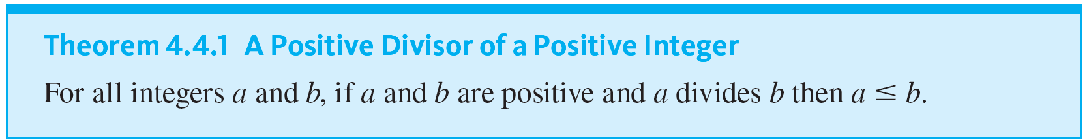
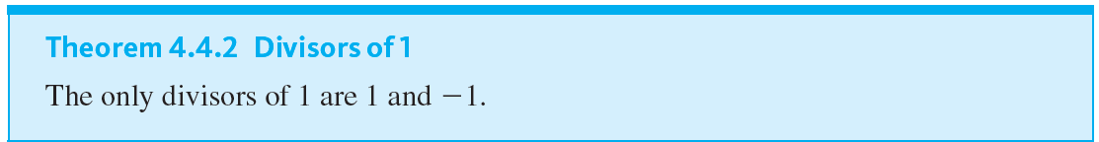
Direct Proof and Counterexample Ⅳ: Divisibility
Two useful properties of divisibility are (1) that if one positive integer divides a second positive integer, then the first is less than or equal to the second, and (2) that the only divisors of 1 are 1 and −1.

Slide 10
Example 4.4.3 – Divisibility and Algebraic Expressions
a. If a and b are integers, is 3a + 3b divisible by 3?
b. If k and m are integers, is 10km divisible by 5?

Slide 11
Example 4.4.3 – Solution
a. Yes. By the distributive law of algebra, 3a + 3b = 3(a + b) and a + b is an integer because it is a sum of two integers.
b. Yes. By the associative law of algebra, 10km = 5 · (2km) and 2km is an integer because it is a product of three integers.

Slide 12

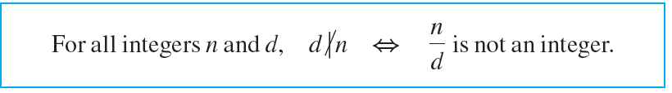
Direct Proof and Counterexample Ⅳ: Divisibility
When the definition of divides is rewritten formally using the existential quantifier, the result is
Since the negation of an existential statement is universal, it follows that d does not divide n (denoted
) if, and only if, ∀ integer k, n ≠ dk or d = 0; in other words, the quotient n ∕ d is not an integer.

Slide 13

Example 4.4.4 – Checking Nondivisibility
Does

Slide 14

Example 4.4.4 – Solution
No,
which is not an integer.

Slide 15
Example 4.4.5 – Prime Numbers and Divisibility
An alternative way to define a prime number is to say that an integer n > 1 is prime if, and only if, its only positive integer divisors are 1 and itself.

Slide 16
Proving Properties of Divisibility

Slide 17

Example 4.4.6 – Transitivity of Divisibility
Prove that for all integers a, b, and c, if

Slide 18



Example 4.4.6 – Solution
Since the statement to be proved is already written formally, you can immediately pick out the starting point, or first sentence of the proof, and the conclusion that must be shown.
Starting Point: Suppose a, b, and c are particular but arbitrarily chosen integers such that
To Show:
or, in other words, that
c = a · (some integer).
You need to show that

Slide 19

Example 4.4.6 – Solution
continued
b = ar for some integer r. 4.4.1
And since
c = bs for some integer s. 4.4.2
Equation 4.4.2 expresses c in terms of b, and equation 4.4.1 expresses b in terms of a. Thus if you substitute 4.4.1 into 4.4.2, you will have an equation that expresses c in terms of a.

Slide 20
Example 4.4.6 – Solution
continued
c = bs by equation 4.4.2
= (ar)s by equation 4.4.1.
But (ar)s = a(rs) by the associative law for multiplication. Hence
c = a(rs).
Now you are almost finished. You have expressed c as a · (something). It remains only to verify that that something is an integer. But of course it is, because it is a product of two integers.

Slide 21
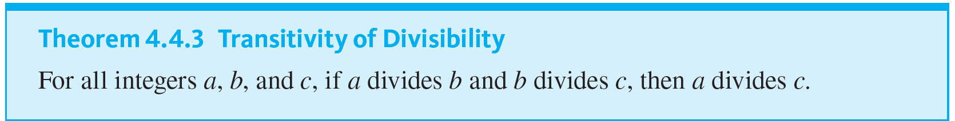
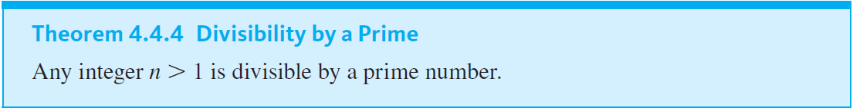
Proving Properties of Divisibility

Slide 22
Counterexamples and Divisibility

Slide 23

Example 4.4.7 – Checking a Proposed Divisibility Property
Is the following statement true or false? For all integers a and b, if

Slide 24
Example 4.4.7 – Solution
This statement is false. Can you think of a counterexample just by concentrating for a minute or so?
The following discussion describes a mental process that may take just a few seconds. It is helpful to be able to use it consciously, however, to solve more difficult problems.
To discover the truth or falsity of a statement such as the one given above, start off much as you would if you were trying to prove it.

Slide 25


Example 4.4.7 – Solution
continued
Starting Point: Suppose a and b are integers such that
Ask yourself, “Must it follow that a = b, or could it happen that a ≠ b for some a and b?” Focus on the supposition. What does it mean? By definition of divisibility, the conditions
b = ha and a = kb for some integers h and k.
Must it follow that a = b, or can you find integers a and b that satisfy these equations for which a ≠ b?

Slide 26

Example 4.4.7 – Solution
continued
The equations imply that
b = ha = h(kb) = (hk)b.
Since
b ≠ 0, and so you can cancel b from the extreme left and right sides to obtain
1 = hk.
In other words, h and k are divisors of 1. But, by Theorem 4.4.2, the only divisors of 1 are 1 and −1. Thus h and k are both 1 or are both −1.

Slide 27
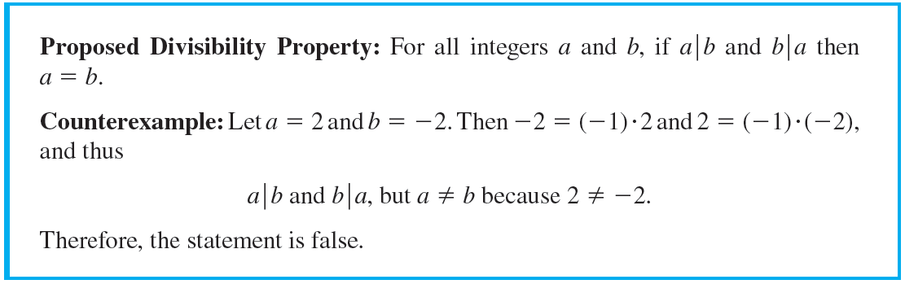
Example 4.4.7 – Solution
continued
If h = k = 1, then b = a. But if h = k = −1, then b = −a and so a ≠ b.
This analysis suggests that you can find a counterexample by taking b = −a. Here is a formal answer:

Slide 28
The Unique Factorization of Integers Theorem

Slide 29
The Unique Factorization of Integers Theorem
The most comprehensive statement about divisibility of integers is contained in the unique factorization of integers theorem.
Because of its importance, this theorem is also called the fundamental theorem of arithmetic.
The unique factorization of integers theorem says that any integer greater than 1 either is prime or can be written as a product of prime numbers in a way that is unique except, perhaps, for the order in which the primes are written.

Slide 30
The Unique Factorization of Integers Theorem
For example,
72 = 2 · 2 · 2 · 3 · 3 = 2 · 3 · 3 · 2 · 2 = 3 · 2 · 2 · 3 · 2,
and so forth.
The three 2’s and two 3’s may be written in any order, but any factorization of 72 as a product of primes must contain exactly three 2’s and two 3’s—no other collection of prime numbers besides three 2’s and two 3’s multiplies out to 72.

Slide 31
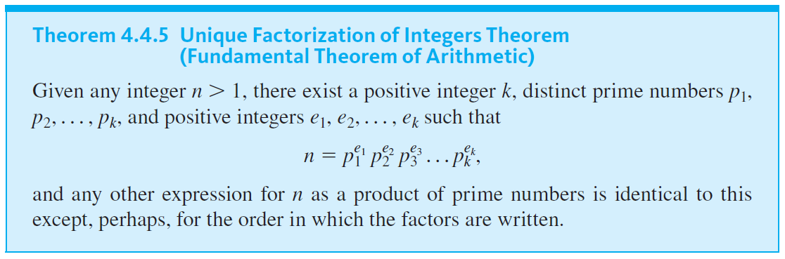
The Unique Factorization of Integers Theorem

Slide 32
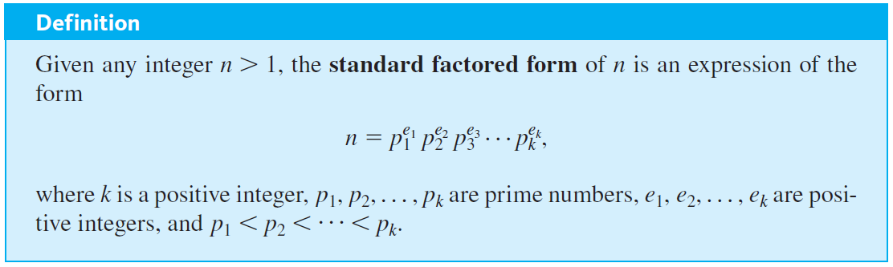
The Unique Factorization of Integers Theorem

Slide 33
Example 4.4.8 – Writing Integers in Standard Factored Form
Write 3,300 in standard factored form.

Slide 34
Example 4.4.8 – Solution
First find all the factors of 3,300. Then write them in ascending order:
3,300 = 100 · 33 = 4 · 25 · 3 · 11

Slide 35

Example 4.4.9 – Using Unique Factorization to Solve a Problem
Suppose m is an integer such that
8 · 7 · 6 · 5 · 4 · 3 · 2 · m = 17 · 16 · 15 · 14 · 13 · 12 · 11 · 10.
Does

Slide 36

Example 4.4.9 – Solution
Since 17 is one of the prime factors of the right-hand side of the equation, it is also a prime factor of the left-hand side (by the unique factorization of integers theorem).
But 17 does not equal any prime factor of 8, 7, 6, 5, 4, 3, or 2 (because it is too large).
Hence 17 must occur as one of the prime factors of m, and so

